Slide 1
Employee Data Analysis using Excel
STUDENT NAME: P.JEEVITHA
REGISTER NO: 312200252, asunm103unm103312200252,
1B909684DB28CB19FEA4F90378126BF1,
DEPARTMENT: B.COM ACCOUNT&FINANCE 3rd year
COLLEGE: S.I.V.E.T COLLEGE

Slide 2
PROJECT TITLE
Employee perormance Analysis using Excel

Slide 3


AGENDA
Problem Statement
Project Overview
End Users
Our Solution and Proposition
Dataset Description
Modelling Approach
Results and Discussion
Conclusion
3/21/2024 Annual Review

Slide 4

PROBLEM STATEMENT
1.Budgeting and Financial Planning
2.Fair Compensation
3.Performance Evaluation
4.Attracting Talent
5.Internal Equity
6.Employee Retention

Slide 5

PROJECT OVERVIEW
.
Analysing the perfomance of the employee by consdering varios factors like agenda,performance,rating,achievements in order to identify the trends and patterns of different categories of employees like permanent salary,fixed term salary,temprary salary.

Slide 6

WHO ARE THE END USERS?
1.Employee
2.Employer
3.Manager
4.Human Resources (HR)
5.Finance Department
6.External Auditors or Consultants
7.Recruitment Teams

Slide 7

OUR SOLUTION AND ITS VALUE PROPOSITION
1.PIVOT TABLE
* Pivot tables are used for data analysis in organizations because they allow you to quickly summarize, organize, and analyze large datasets.
2.GRAPH
*Graphs are used for analysis in organizations because they provide a clear and structured way to represent relationships, dependencies, and hierarchies between different entities, such as employees, departments, tasks, or resources.

Slide 8
Dataset Description
1.Download from Edunet
2.total features 9
6 features considered
*Employee ID : alphabet and numerical
*Employee name : In text
*Employee gender : In text (male,Female)
*Employee Department : In text
*Employee salary : In numerical values
*Employee term : In text (FixedPermanent,Temporary)

Slide 9

THE "WOW" IN OUR SOLUTION
focus on enhancing both its functionality and visual appeal.
1.Grouping and Sorting :Group data meaningfully, like by month, quarter, or category, and sort it to display key information at the top. This helps in organizing large datasets and focusing on priorities.
2.Dynamic Charts:Integrate pivot charts that update dynamically when the pivot table changes. Visual charts bring life to the numbers and make data interpretation easier.
3.Clear Summary Insights: Use the pivot table to deliver key insights or KPIs at a glance. For example, emphasize metrics like total revenue, average growth.
3/21/2024 Annual Review
9

Slide 10
MODELLING
1. Download data from Edunet.
2. Select the required information for preparing a pivot table:
Choose the desired data range and create a pivot table by selecting "Insert" and then "Pivot Table." Click "OK."
Drag fields into the appropriate areas in the pivot table and remove any blank fields if present.
*Your pivot table is now ready.
3. Select the completed pivot table, go to the "Insert" tab, and choose "Chart."
*Select the desired chart type and finalize the project.
10

Slide 11
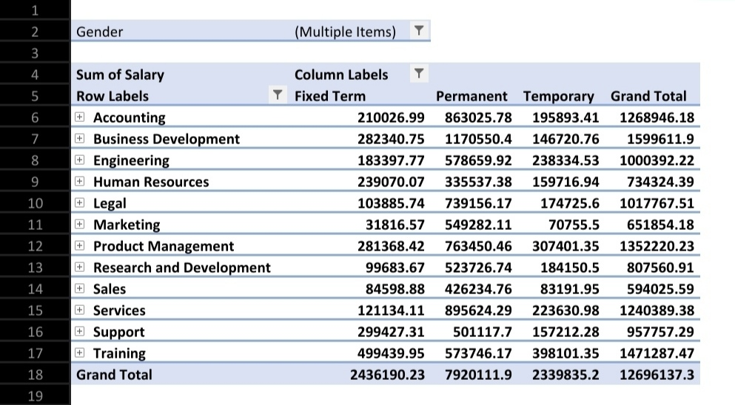
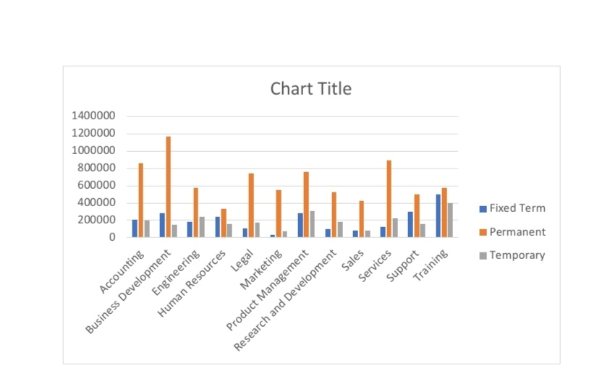
RESULTS
11

Slide 12
conclusion
This chart compares the distribution of three types of employment (Fixed Term, Permanent, and Temporary) across various departments, including Accounting, Business Development, Engineering, Human Resources, Legal, Marketing, Product Management, Research and Development, Sales, Services, Support, and Training. Here are some key conclusions:
1.Permanent Positions Dominate.
2.Fixed Term and Temporary Positions are Less Common.
3.Departmental Variations.
4.Low Usage of Temporary Workers.

